Slide 1

Earth’s Features
Experience 2
Water: Solid or Liquid
https://sites.google.com/wflboces.org/boces4science/home
Grade 2

Slide 2
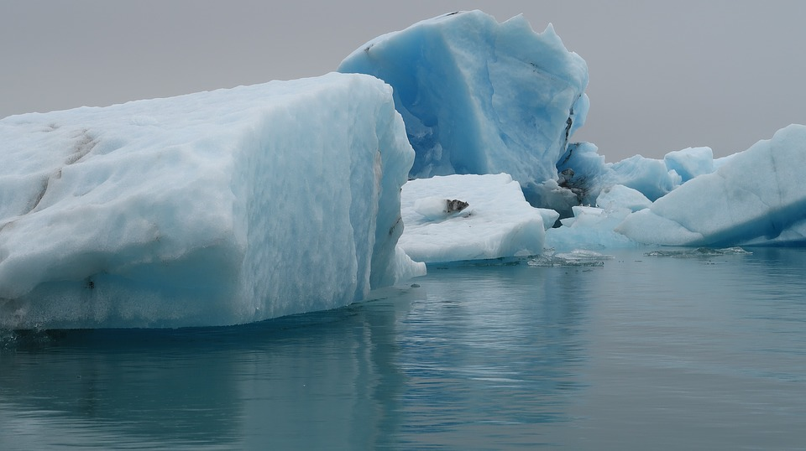
Water on earth
Where is water located on Earth?
Is the water liquid or solid? How do you know?
Water on Earth:
https://www.youtube.com/watch?v=wZK2xTNzgq8

Slide 3
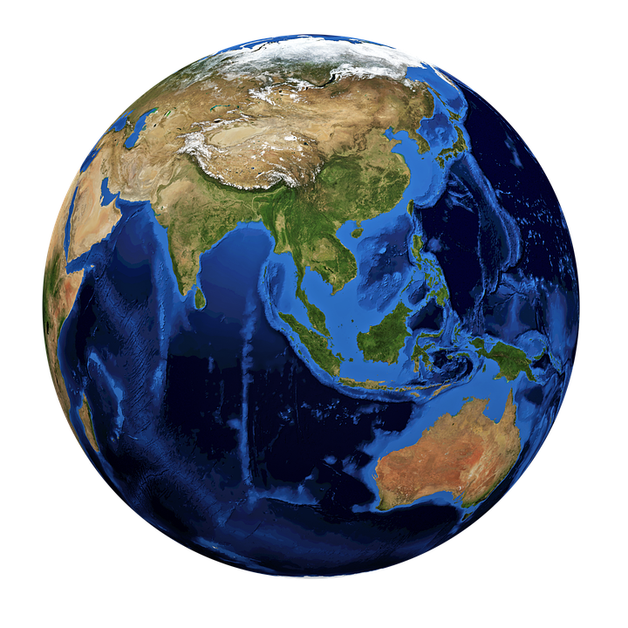
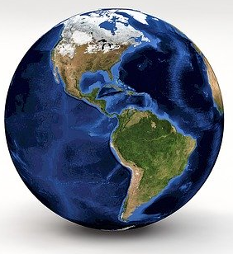
World Map
Look close at the globes.
Observe where water is located.
Observe the pattern of color for
  water.
Is the water frozen or liquid and
how do you know?
5. Use the worksheet with this
experience.

